Slide 1
Things we done for electronic circuit design

Slide 2
Schematic – Power supply

Slide 3
Schematic – Power supply
230V
230-12V Step down transformer
Power supply

Slide 4
Schematic – µProcessor
Atmel ATMEGA328

Slide 5
Schematic – RS232 Interface

Slide 6
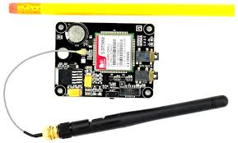
Schematic – RS232 Interface
uProcessor
RS232 interface
GSM module

Slide 7
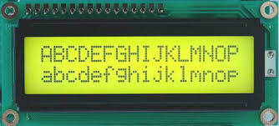
Schematic – LCD connector

Slide 8
Schematic – LCD connector
4bit Mode
uProcessor
LCD

Slide 9
Things to be done for the circuit design

Slide 10
To be done……..
Add interface to communicate with thermal printing machine.
Add multiplexor to use all service providers.

